Slide 1
LLM & RL Papers
Miangyang Chen
2024/3

Slide 2
Content of Table
1/ Cross Study Overview
2/Papers

Slide 3
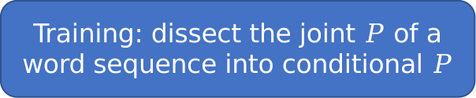
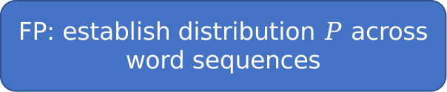
Cross Study Overview
Training: dissect the joint $P$ of a word sequence into conditional $P$
FP: establish distribution $P$across word sequences
Language
Module
unidirectional
n-gram module
chat
GPT
BERT
PaLM
LaMDA
...
atuhor essay
summarize
bidirectional
Transformer
translate
Pternea, Moschoula, et al. "The RL/LLM Taxonomy Tree: Reviewing Synergies Between Reinforcement Learning and Large Language Models." arXiv preprint arXiv:2402.01874 (2024).

Slide 4

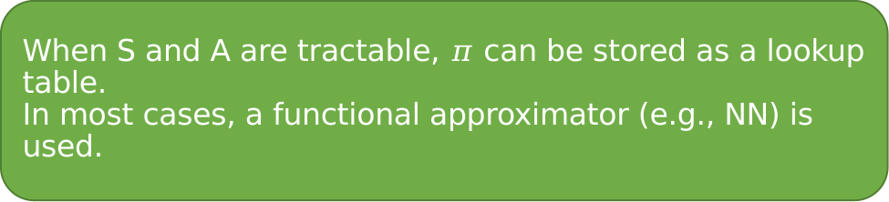




Cross Study Overview
Dynamic Programming
State set: $S$
RL
Method
MDP
approach
Action set: $A$
Monte Carlo
Transition $f:T$
Reward $f$: $R$
Temporal Difference
Policy: $π$
When S and A are tractable, $π$ can be stored as a lookup table.
In most cases, a functional approximator (e.g., NN) is used.
Pternea, Moschoula, et al. "The RL/LLM Taxonomy Tree: Reviewing Synergies Between Reinforcement Learning and Large Language Models." arXiv preprint arXiv:2402.01874 (2024).

Slide 5
Cross Study Overview
Language
Module
train on web-scale corpora
abundant common sense
good at decision making
hallucination
not embodied or grounded
lacked ability in low-level control
short in exploration and self-improvement
Cross
RL
improve policy with interaction
deal with control problem
poor sample efficiency
elusive, poor interpretability
struggle with long-horizen tasks
fail in sparse-reward environments

Slide 6
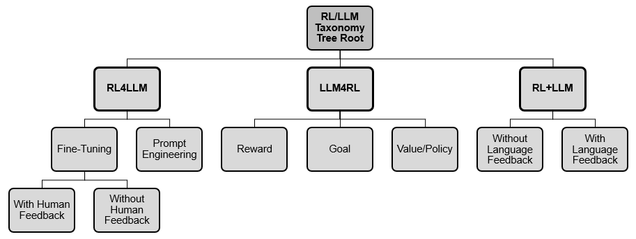
Cross Study Overview
RL4LLM
use RL to tune a trained LLM
improve preformance in specific NLP tasks
LLM4RL
use LLM to help training RL
improve training efficiencity or
performance of a control task
RL+LLM
both well trained
plan over a set of skills
tuneor
train
Pternea, Moschoula, et al. "The RL/LLM Taxonomy Tree: Reviewing Synergies Between Reinforcement Learning and Large Language Models." arXiv preprint arXiv:2402.01874 (2024).

Slide 7
Content of Table
1/ Cross Study Overview
2/Papers

Slide 8
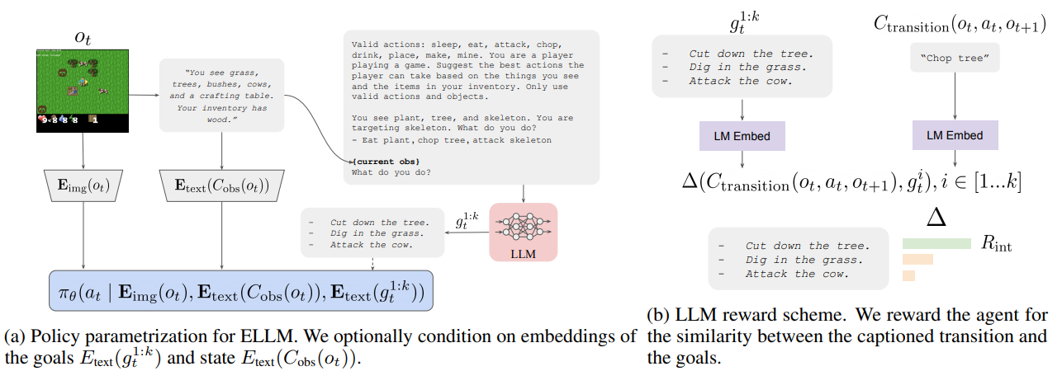
LLM -> RL goals
Use LLM to assign goals for RL agent
Provide LLM with env description and available actions
LLM generates meaningful goals for RL to learn
Reward is also generated by LLM
Du, Yuqing, et al. "Guiding pretraining in reinforcement learning with large language models." International Conference on Machine Learning. PMLR, 2023.

Slide 9
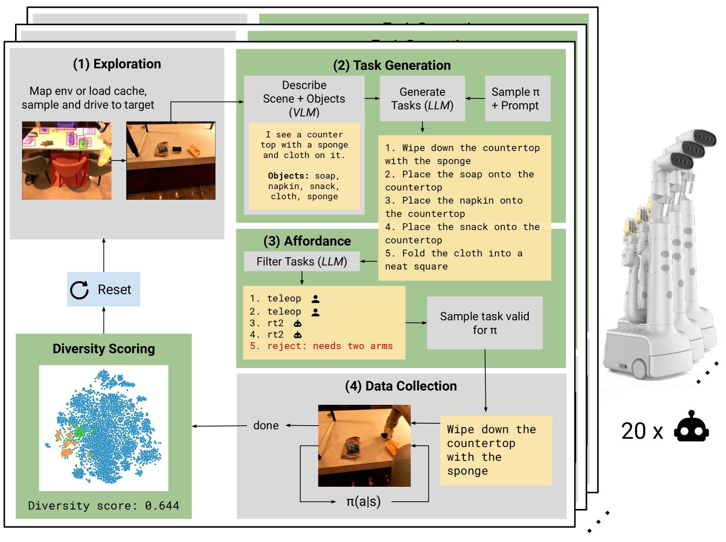
LLM -> RL goals
Use LLM to assign tasks to robots, and implemented by robotics learning(e.g. RL) to collect diverse and abundant data for future
Framework Overview
Navigate robots to interesting scene
Provide state description(VLM), and skills, LLM generates tasks.
Sample one eligible task to perform
Collect diverse data
Ahn, Michael, et al. "Autort: Embodied foundation models for large scale orchestration of robotic agents." arXiv preprint arXiv:2401.12963 (2024).

Slide 10
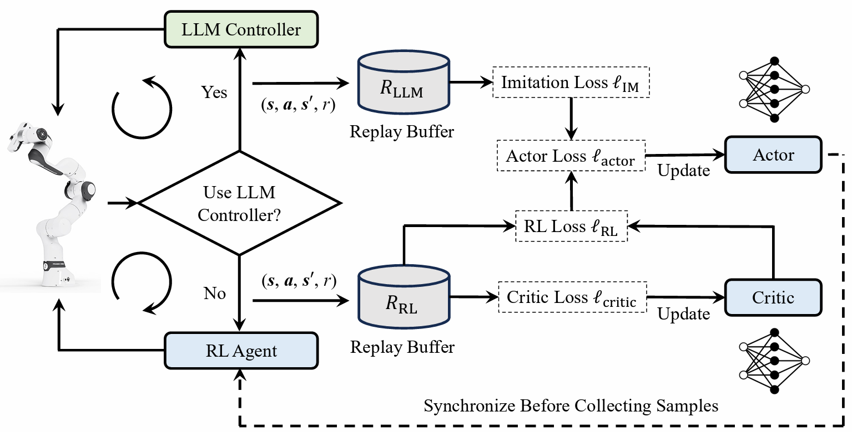
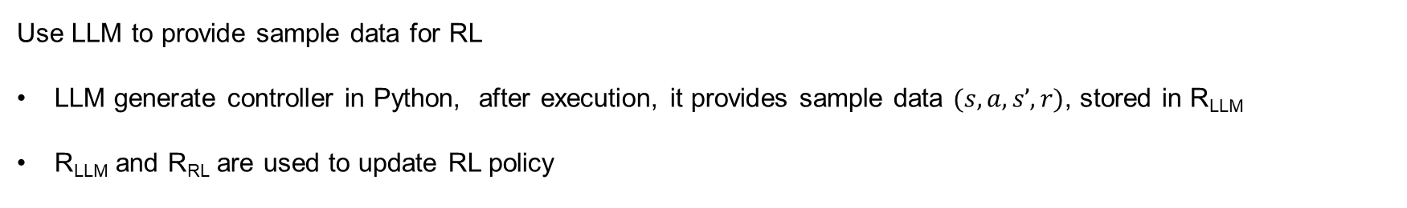
LLM -> RL value/policy
Use LLM to provide sample data for RL
LLM generate controller in Python, after execution, it provides sample data $(s, a, s’, r)$, stored in R_{LLM}
R_{LLM} and R_{RL} are used to update RL policy
Chen, Liangliang, et al. "RLingua: Improving Reinforcement Learning Sample Efficiency in Robotic Manipulations With Large Language Models." arXiv preprint arXiv:2403.06420 (2024).

Slide 11
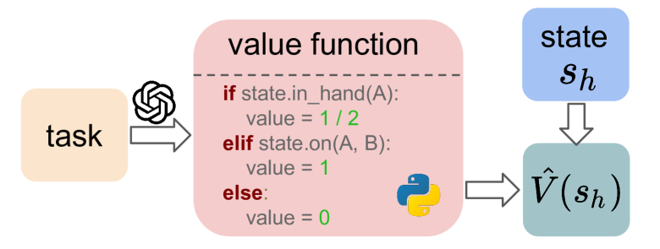
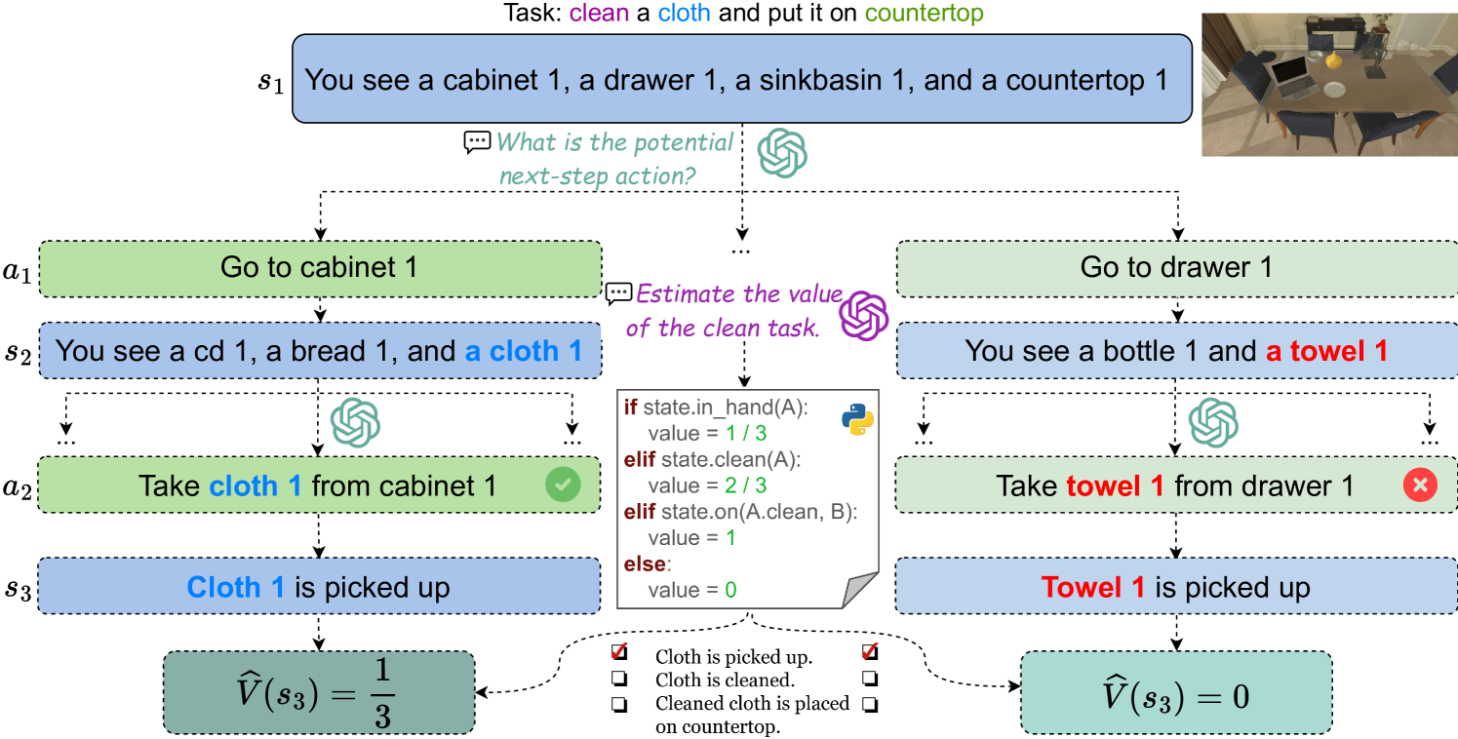
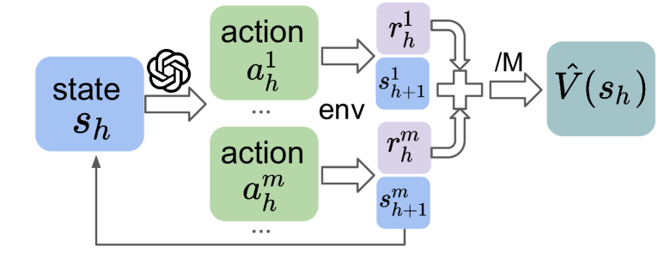
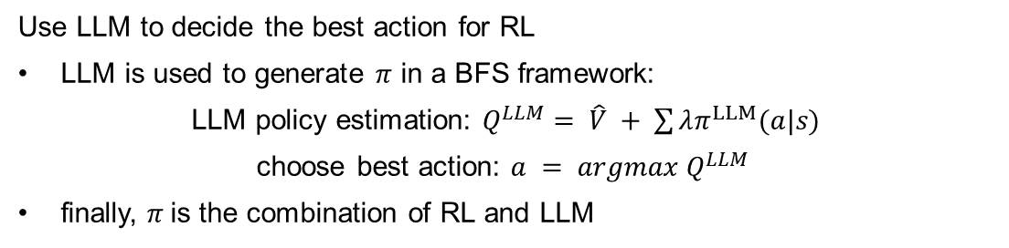
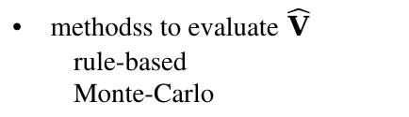
LLM -> RL value/policy
Use LLM to decide the best action for RL
LLM is used to generate $π$ in a BFS framework:
LLM policy estimation: $Q^{LLM}= \hat{V} + \sum{λπ^{LLM}(a|s)}$
choose best action: $a = argmax{ Q}^{LLM}$
finally, $π$is the combination of RL and LLM
methodss to evaluate $\hat{V}$
rule-based
Monte-Carlo
scenarios where achieving goal requires fulfilling multiple preconditions
when goal’s preconditions are hard to determine:
BFS: N=2, k=3, branch=9
Zhang, Shenao, et al. "How Can LLM Guide RL? A Value-Based Approach." arXiv preprint arXiv:2402.16181 (2024).77

Slide 12
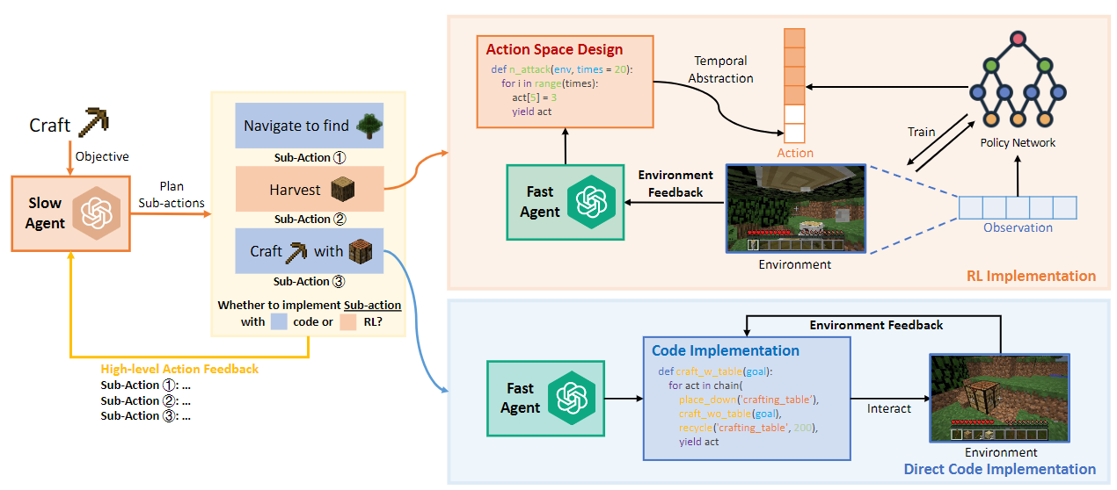
LLM -> RL policy
Use LLM to plan, write code and design action for RL
A_{F} LLM decomposes Task to sub-actions
A_{S} LLM transform action to code
- simple action is coded by LLM directly
- challenging action is solved by RL and LLM together
Critic feedback:
for A_{F}, produce error-free Python code aligning with action
for A_{S}, improve action planning
Liu, Shaoteng, et al. "RL-GPT: Integrating Reinforcement Learning and Code-as-policy." arXiv preprint arXiv:2402.19299 (2024)

Slide 13
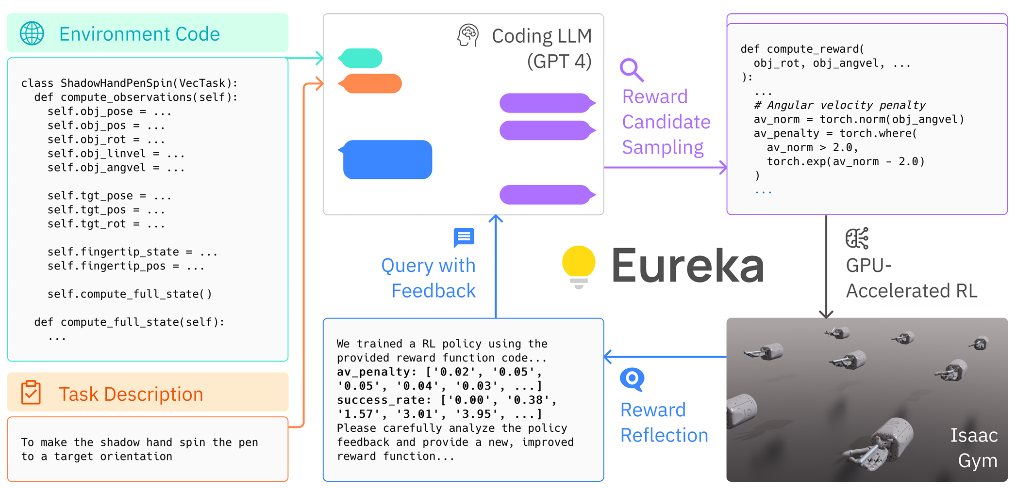
LLM -> RL reward
Use LLM to generate reward function
Provide environmentr code and task description
EUREKA can generate reward function directly
Function Improvement:
i. evolutionnary search: static analysis
ii. reward reflection: dynamic analysis
Ma, Yecheng Jason, et al. "Eureka: Human-level reward design via coding large language models." arXiv preprint arXiv:2310.12931 (2023).
Xie, Tianbao, et al. "Text2reward: Automated dense reward function generation for reinforcement learning." arXiv preprint arXiv:2309.11489.

Slide 14
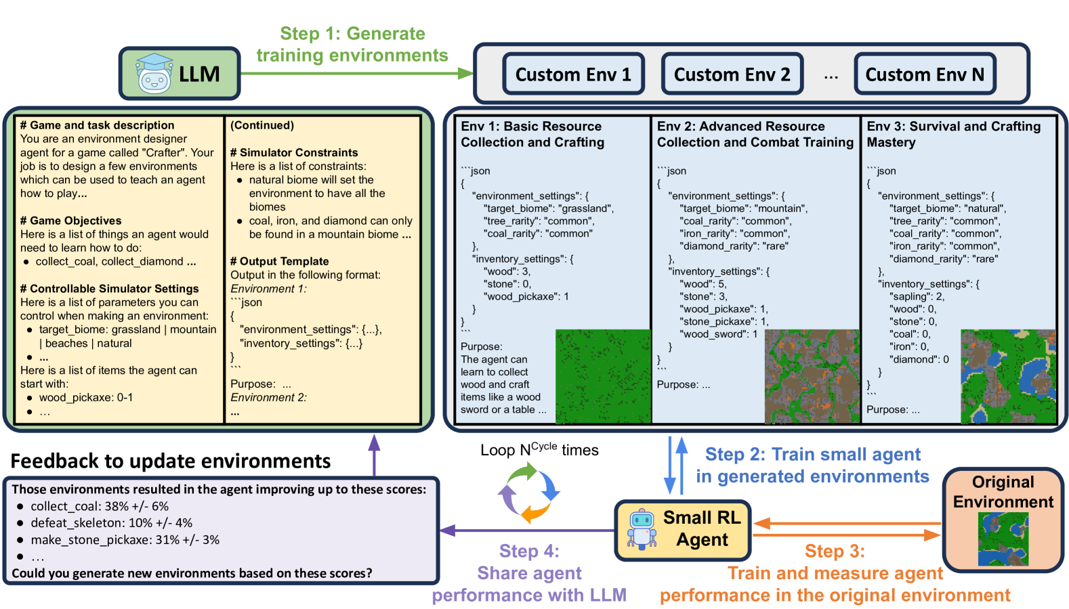
LLM -> RL env
Use LLM to design specific environment to learn skills
Step1: prompt LLM to fill the template, output the Env config.
Step2: train RL in the LLM Custom Env
Step3: train RL in the original Env
Step4: feedback the RL performance to LLM, let it adapt the Env next cycle.
Zala, Abhay, et al. "EnvGen: Generating and Adapting Environments via LLMs for Training Embodied Agents." arXiv preprint arXiv:2403.12014 (2024).

Slide 15
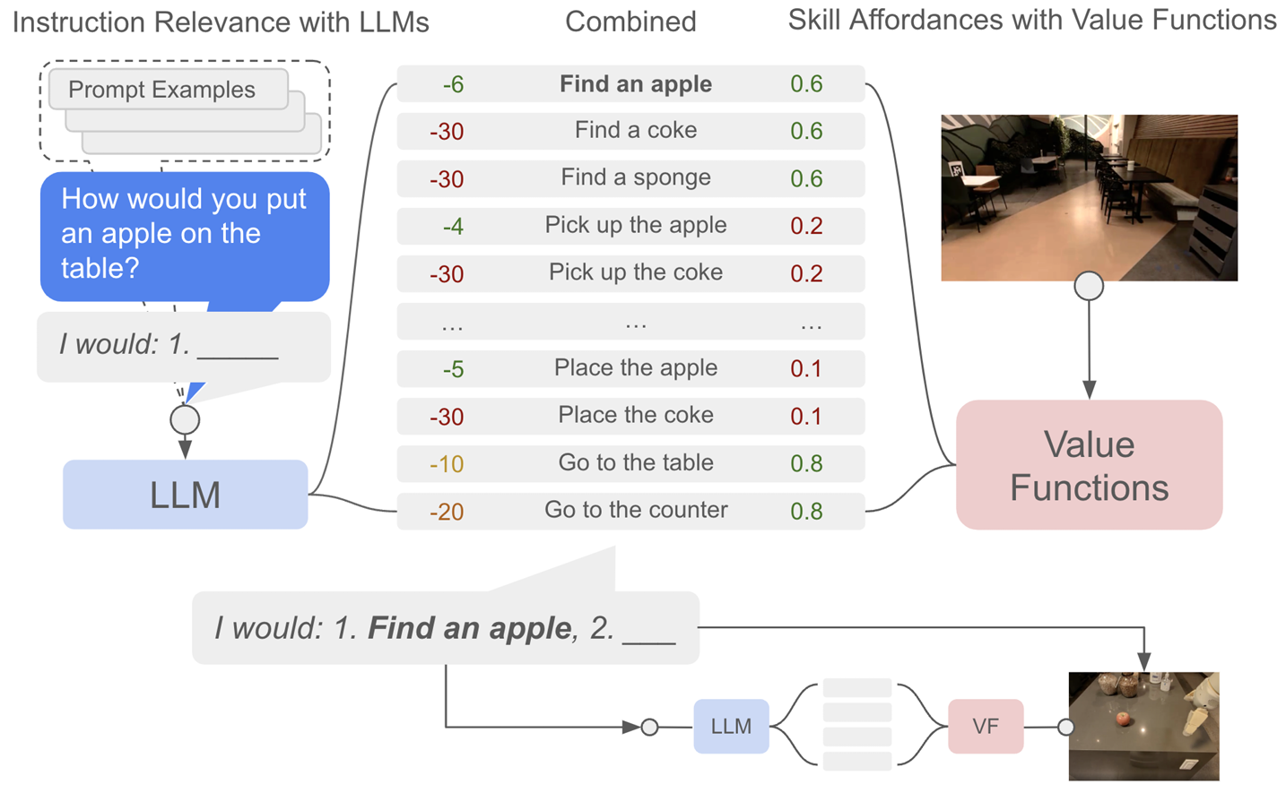
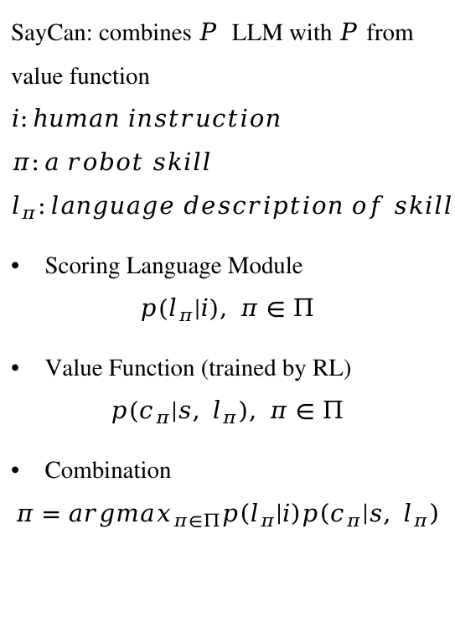
LLM + RL without language feedback
SayCan: combines $P$ LLM with $P$from value function
$$i:human instruction \\ π:a robot skill \\ l_{π}:language description of skill$$
Scoring Language Module
$$p\left(l_{π} | i\right), π∈Π$$
Value Function (trained by RL)
$$p\left(c_{π} | s, l_{π}\right), π∈Π$$
Combination
$$π=argmax_{π∈Π}p\left(l_{π} | i\right)p\left(c_{π} | s, l_{π}\right)$$
Ahn, Michael, et al. "Do as i can, not as i say: Grounding language in robotic affordances." arXiv preprint arXiv:2204.01691 (2022).

Slide 16
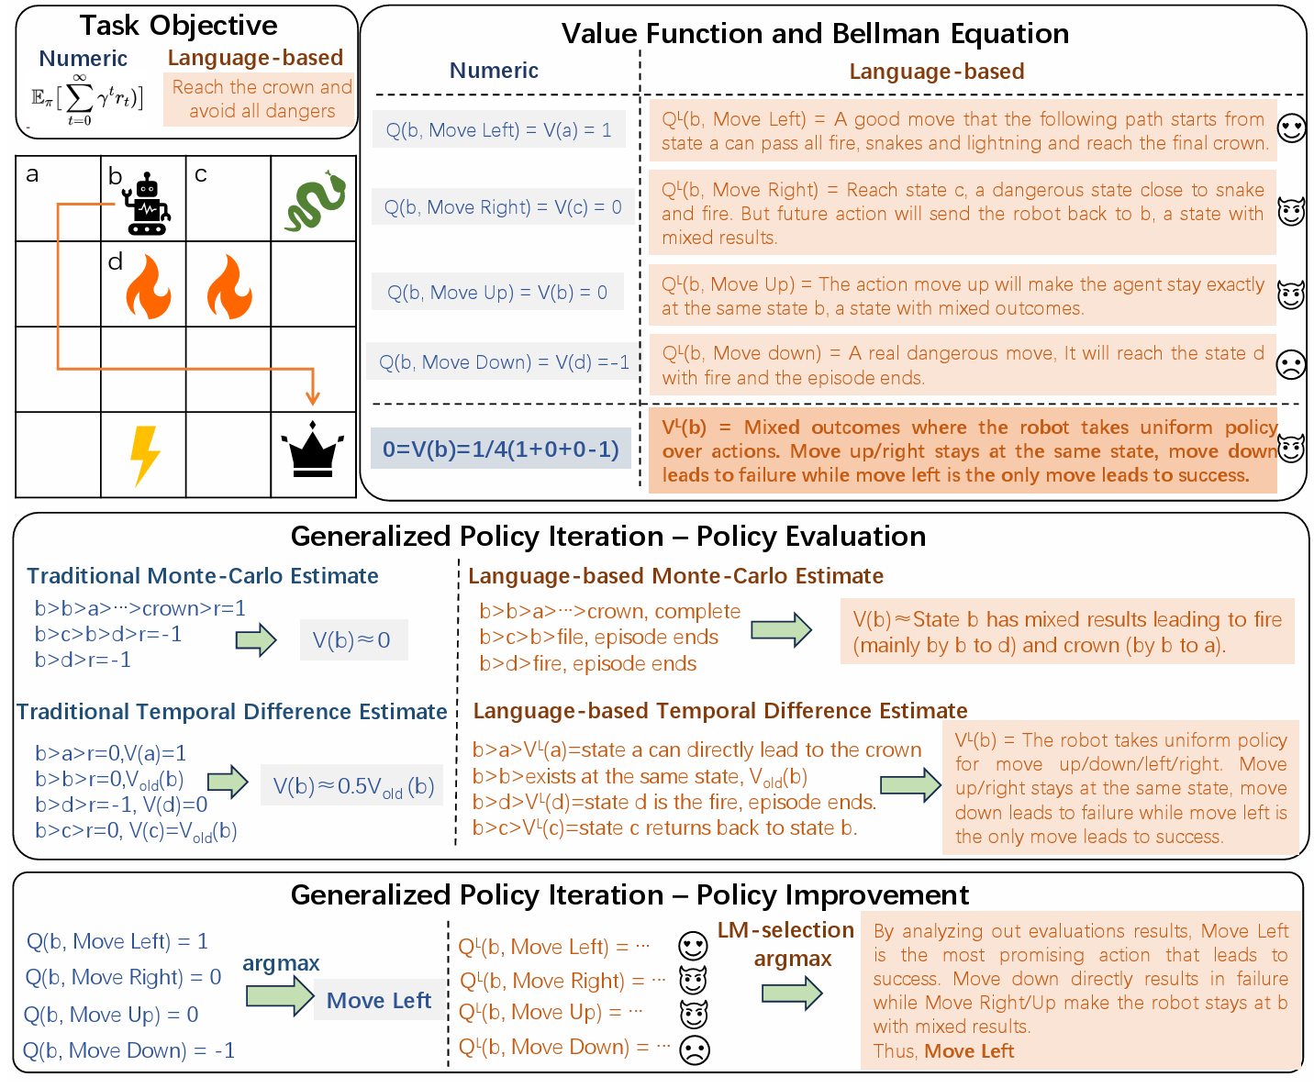
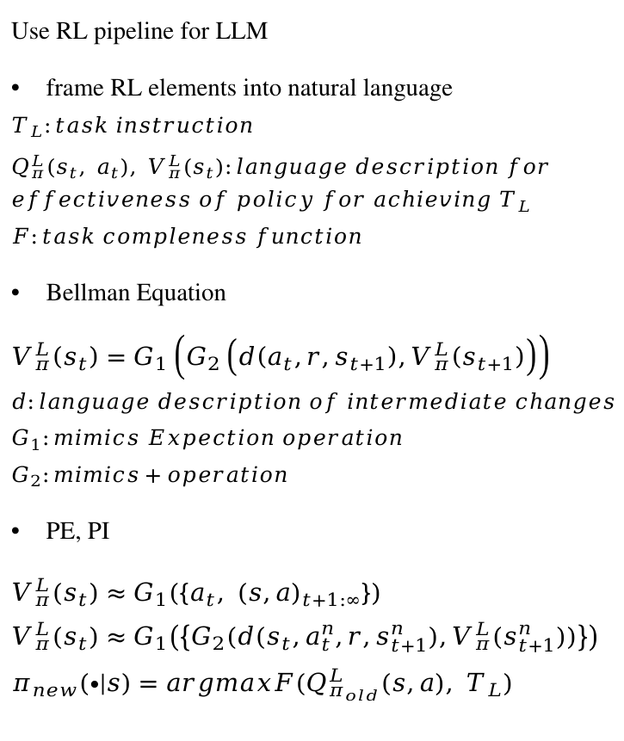
LLM + RL pipeline
Use RL pipeline for LLM
frame RL elements into natural language
$$T_{L}:task instruction \\ Q_{π}^{L}\left(s_{t}, a_{t}\right), V_{π}^{L}\left(s_{t}\right):language description for \\ effectiveness of policy for achieving T_{L} \\ F:task compleness function$$
Bellman Equation
$$V_{π}^{L}\left(s_{t}\right)=G_{1}\left(G_{2}\left(d\left(a_{t},r,s_{t+1}\right),V_{π}^{L}\left(s_{t+1}\right)\right)\right) \\ d:language description of intermediate changes \\ G_{1}:mimics Expection operation \\ G_{2}:mimics+operation$$
PE, PI
$V_{π}^{L}\left(s_{t}\right)≈G_{1}\left(\left\{a_{t}, {\left(s,a\right)}_{t+1:∞}\right\}\right)$
$V_{π}^{L}\left(s_{t}\right)≈G_{1}\left(\left\{G_{2}(d(s_{t},a_{t}^{n},r,s_{t+1}^{n}),V_{π}^{L}(s_{t+1}^{n}))\right\}\right)$ $$π_{new}\left(∙ | s\right)=argmaxF(Q_{π_{old}}^{L}\left(s,a\right), T_{L})$$
Feng, Xidong, et al. "Natural Language Reinforcement Learning." arXiv preprint arXiv:2402.07157 (2024).

Slide 17
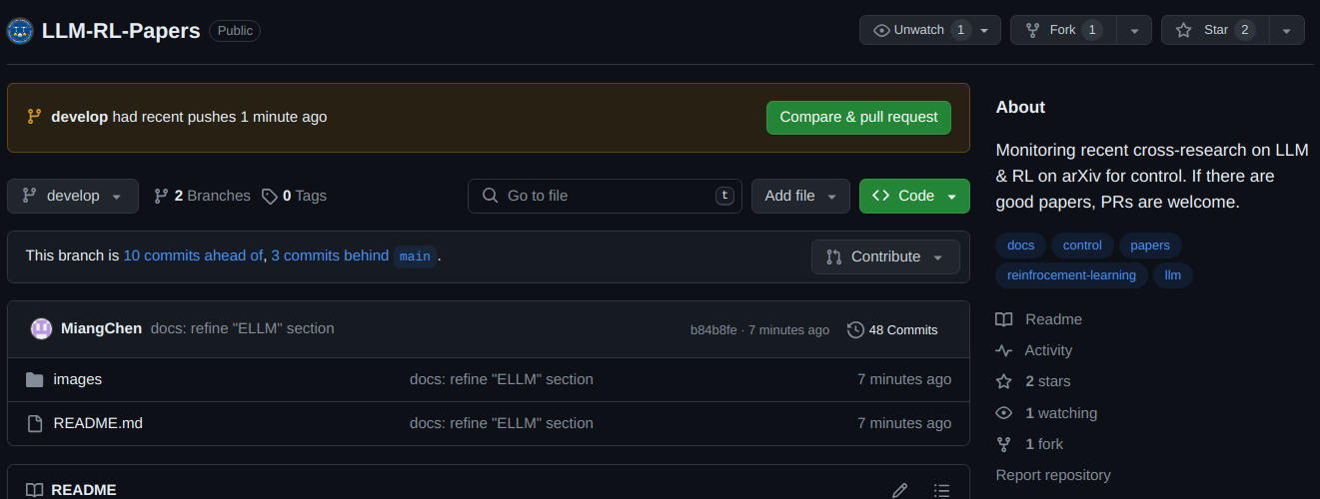
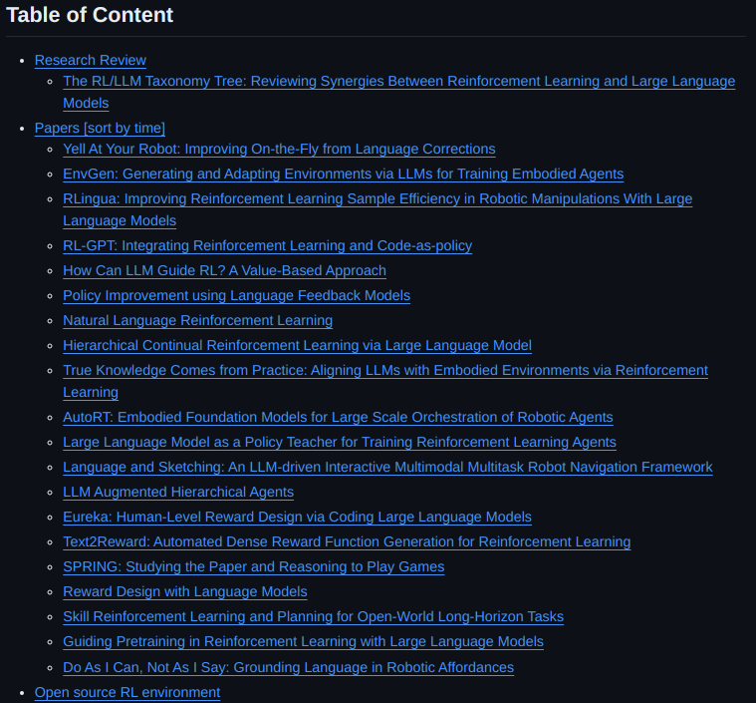
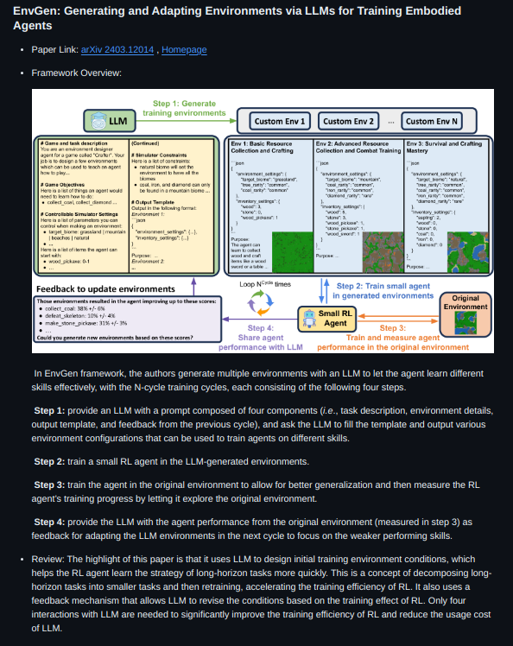
GitHub
LLM-RL-Papers
WestlakeIUSL/LLM-RL-Papers
Collect papers & environments
Focuse on usage for control
Format:
Table of Content
Title
Paper link
Framework Overview
Review

